Slide 1
Sudoku Man
A Glorious Mess Produced By Stephen Turner

Slide 2
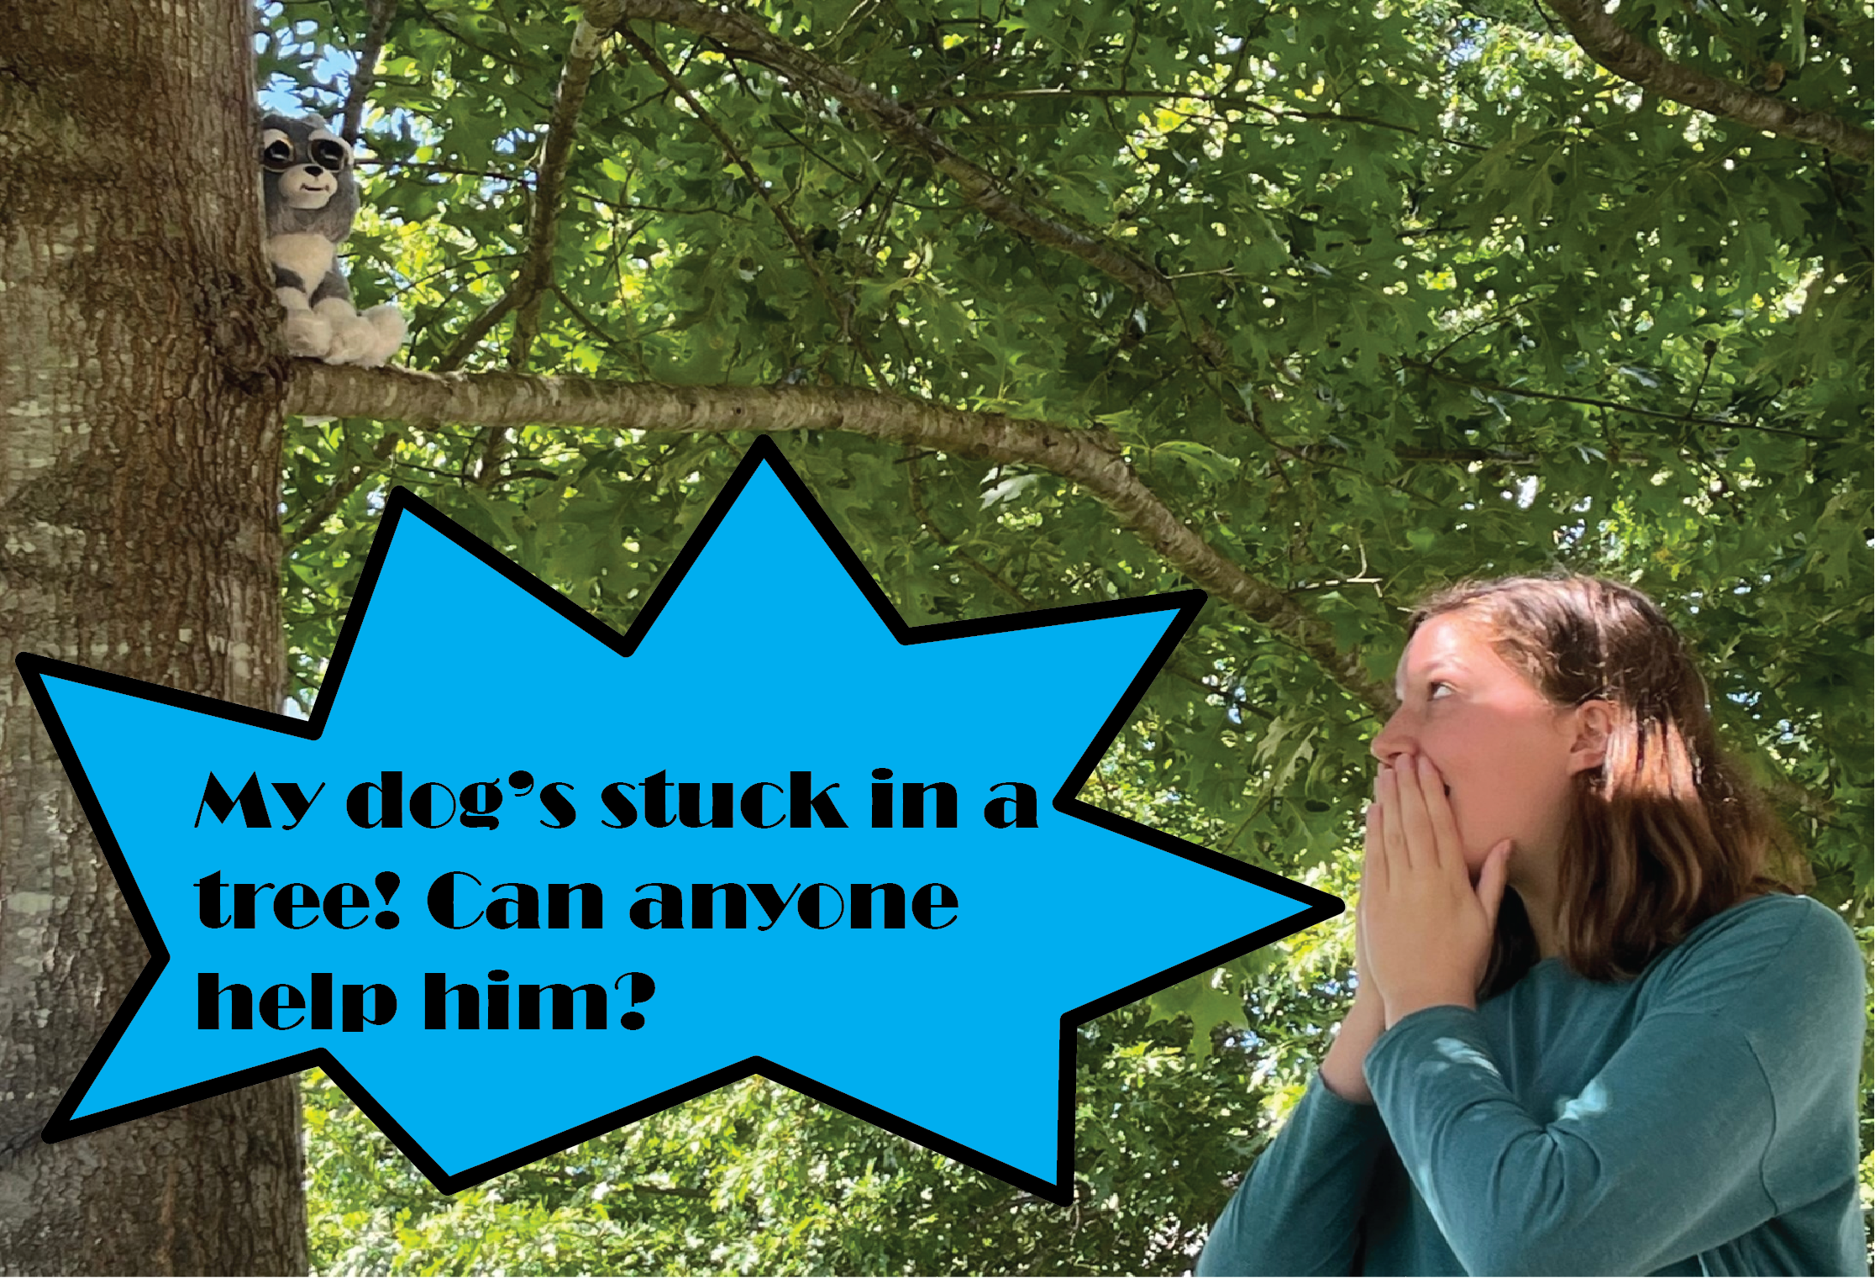

Slide 3
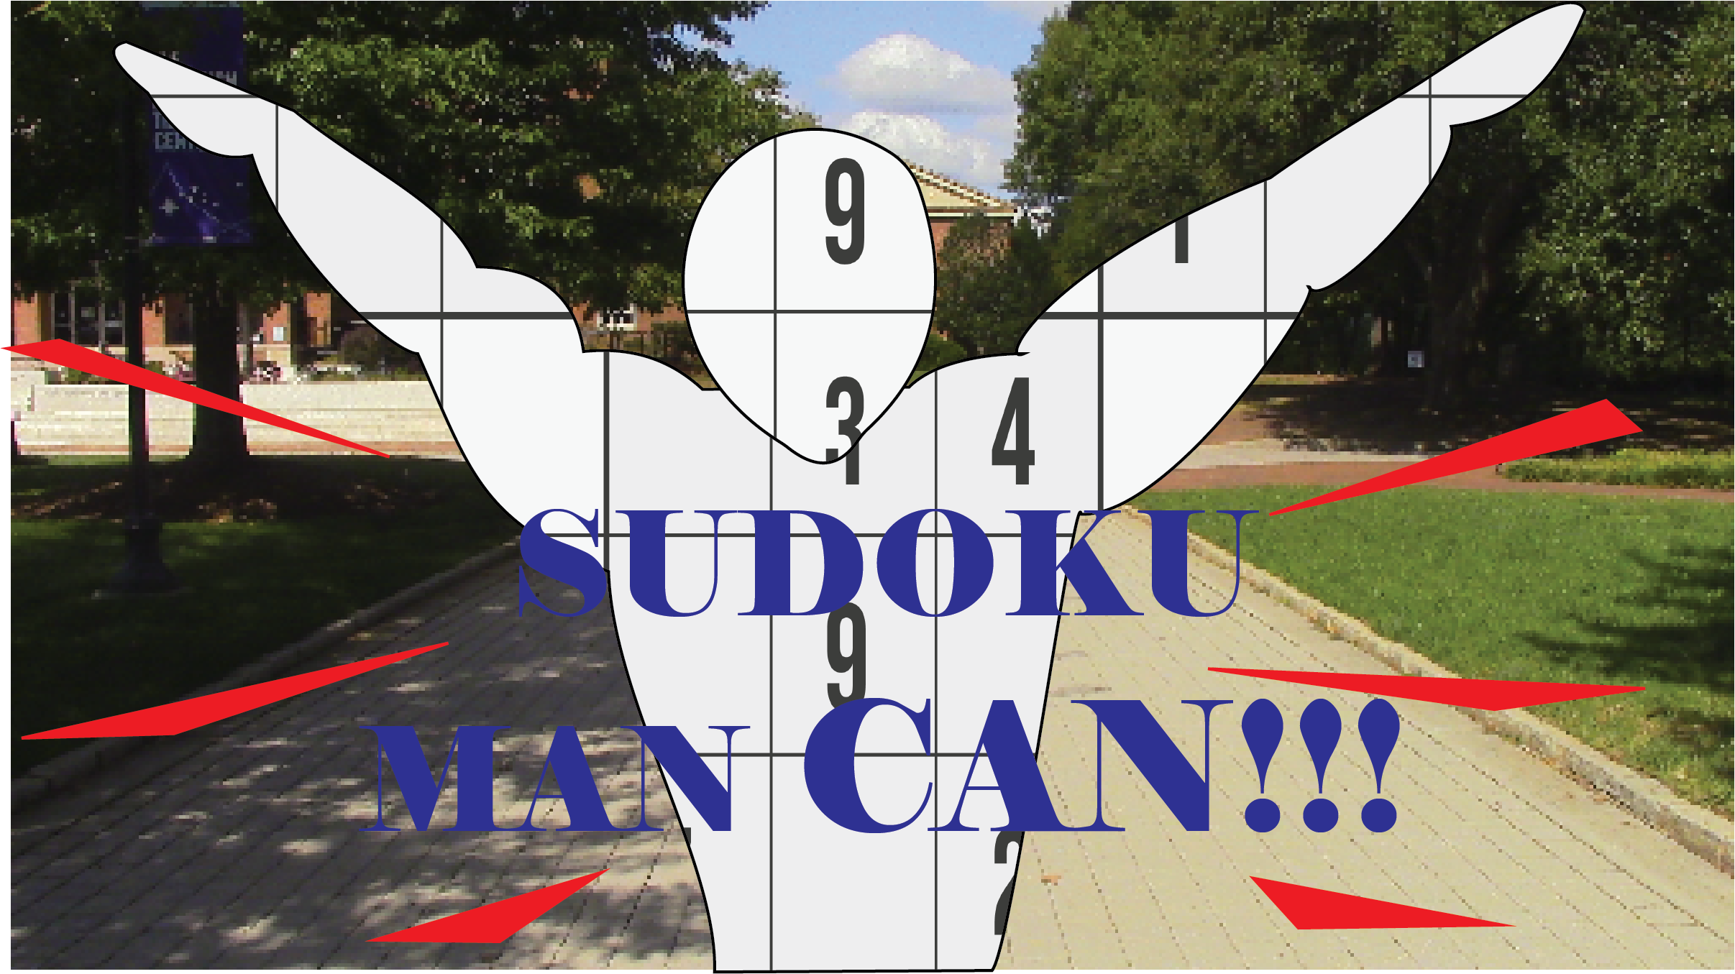

Slide 4
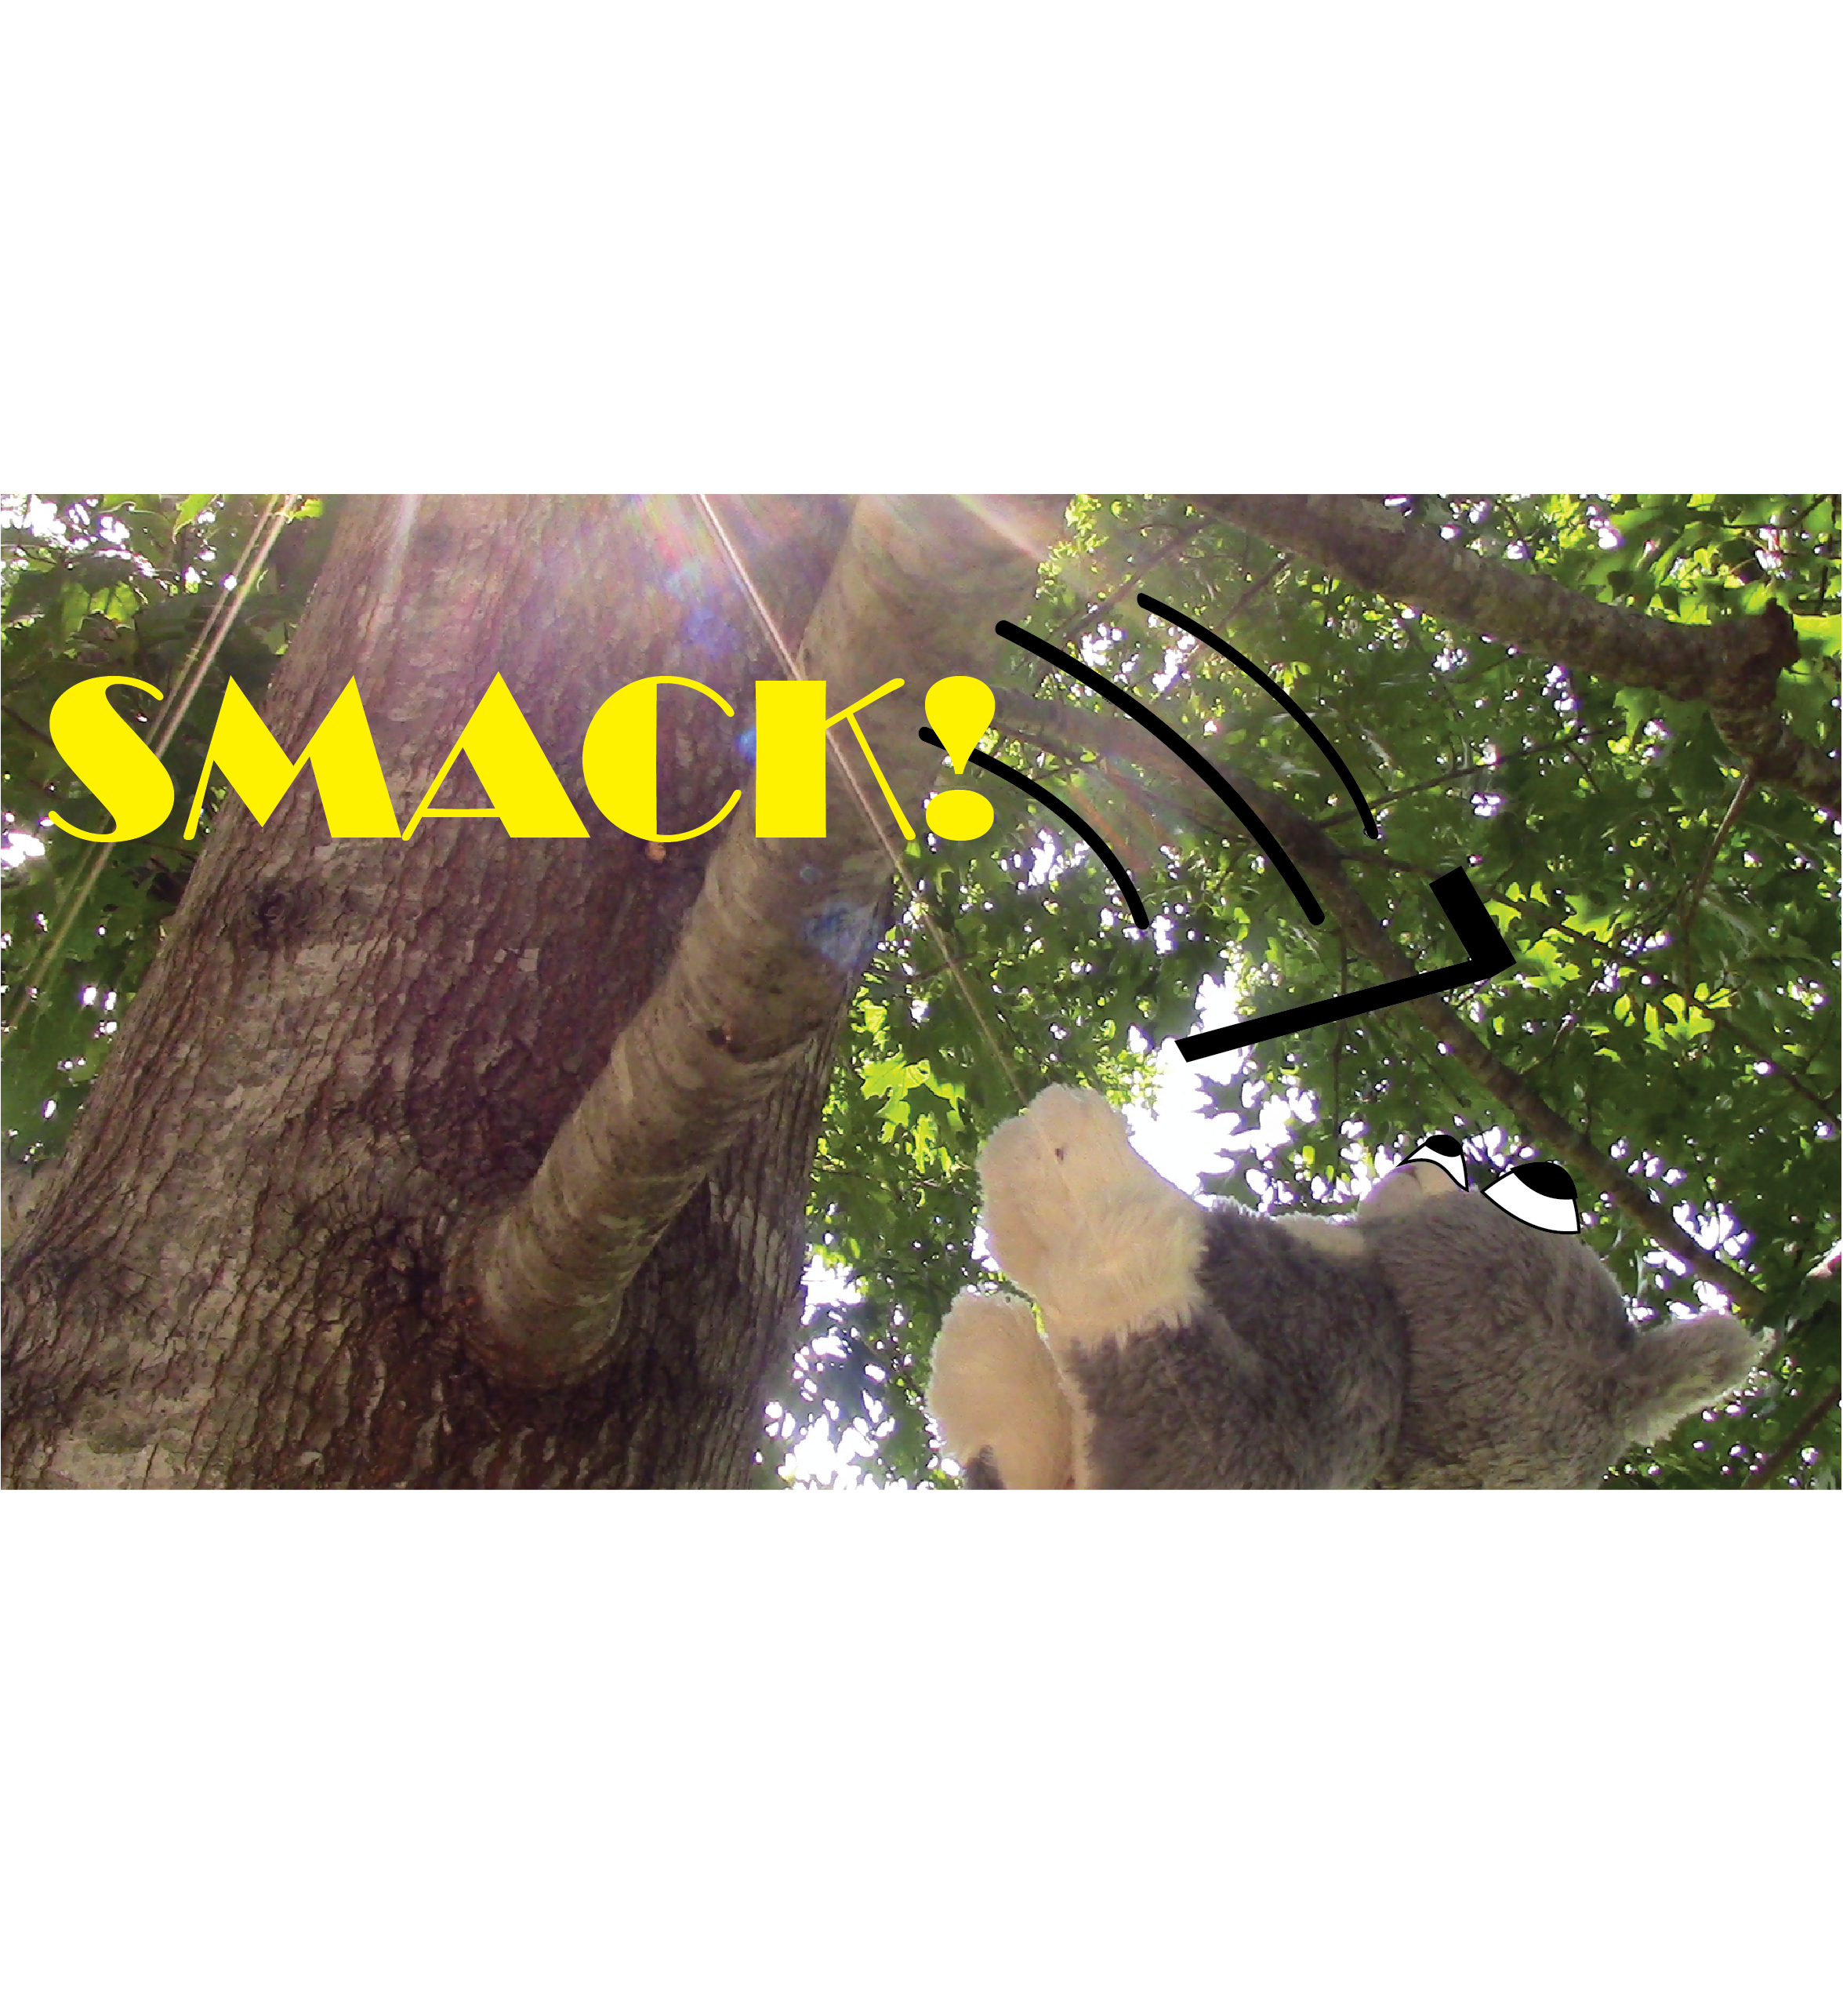

Slide 5
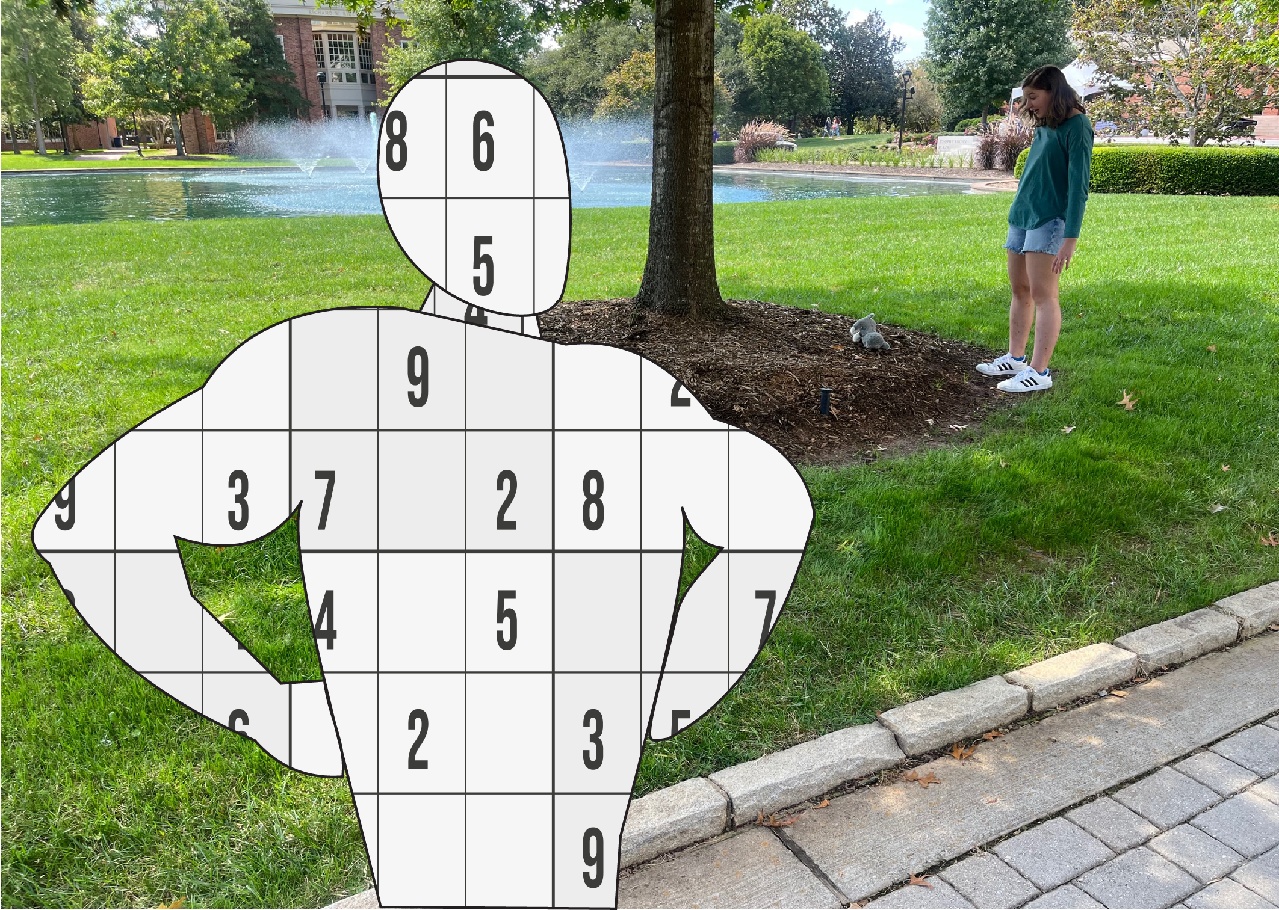

Slide 6
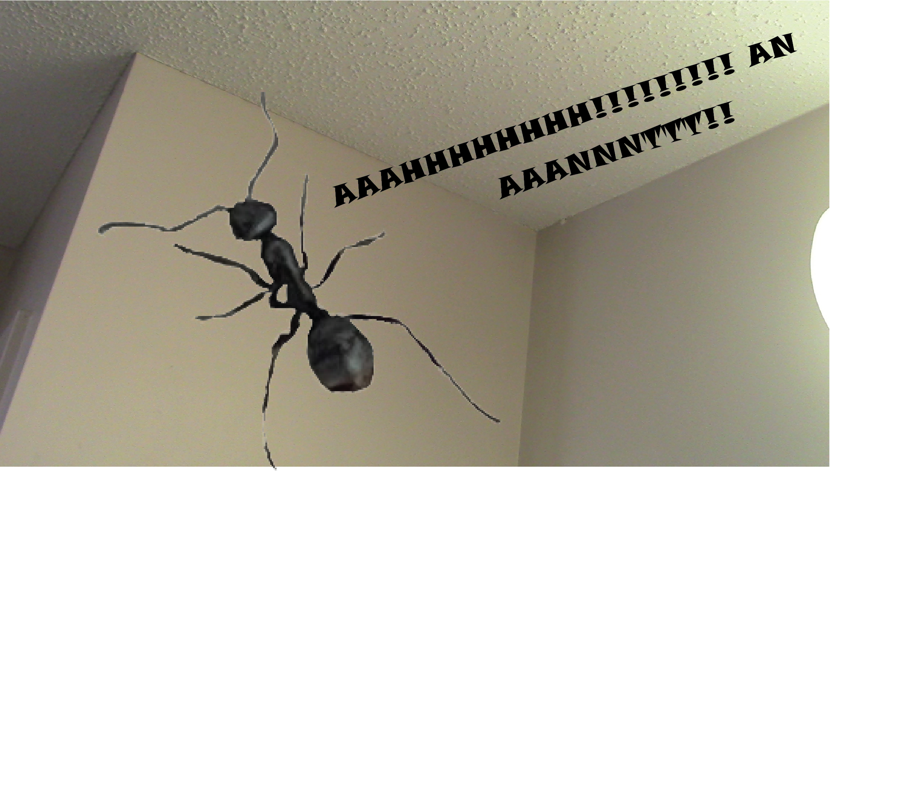

Slide 7
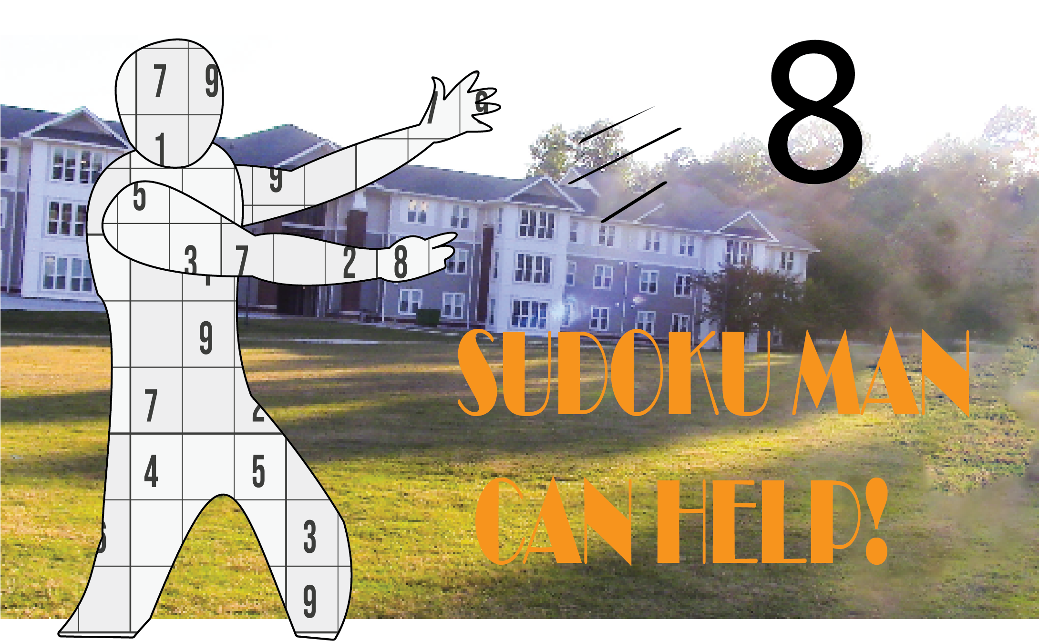

Slide 8
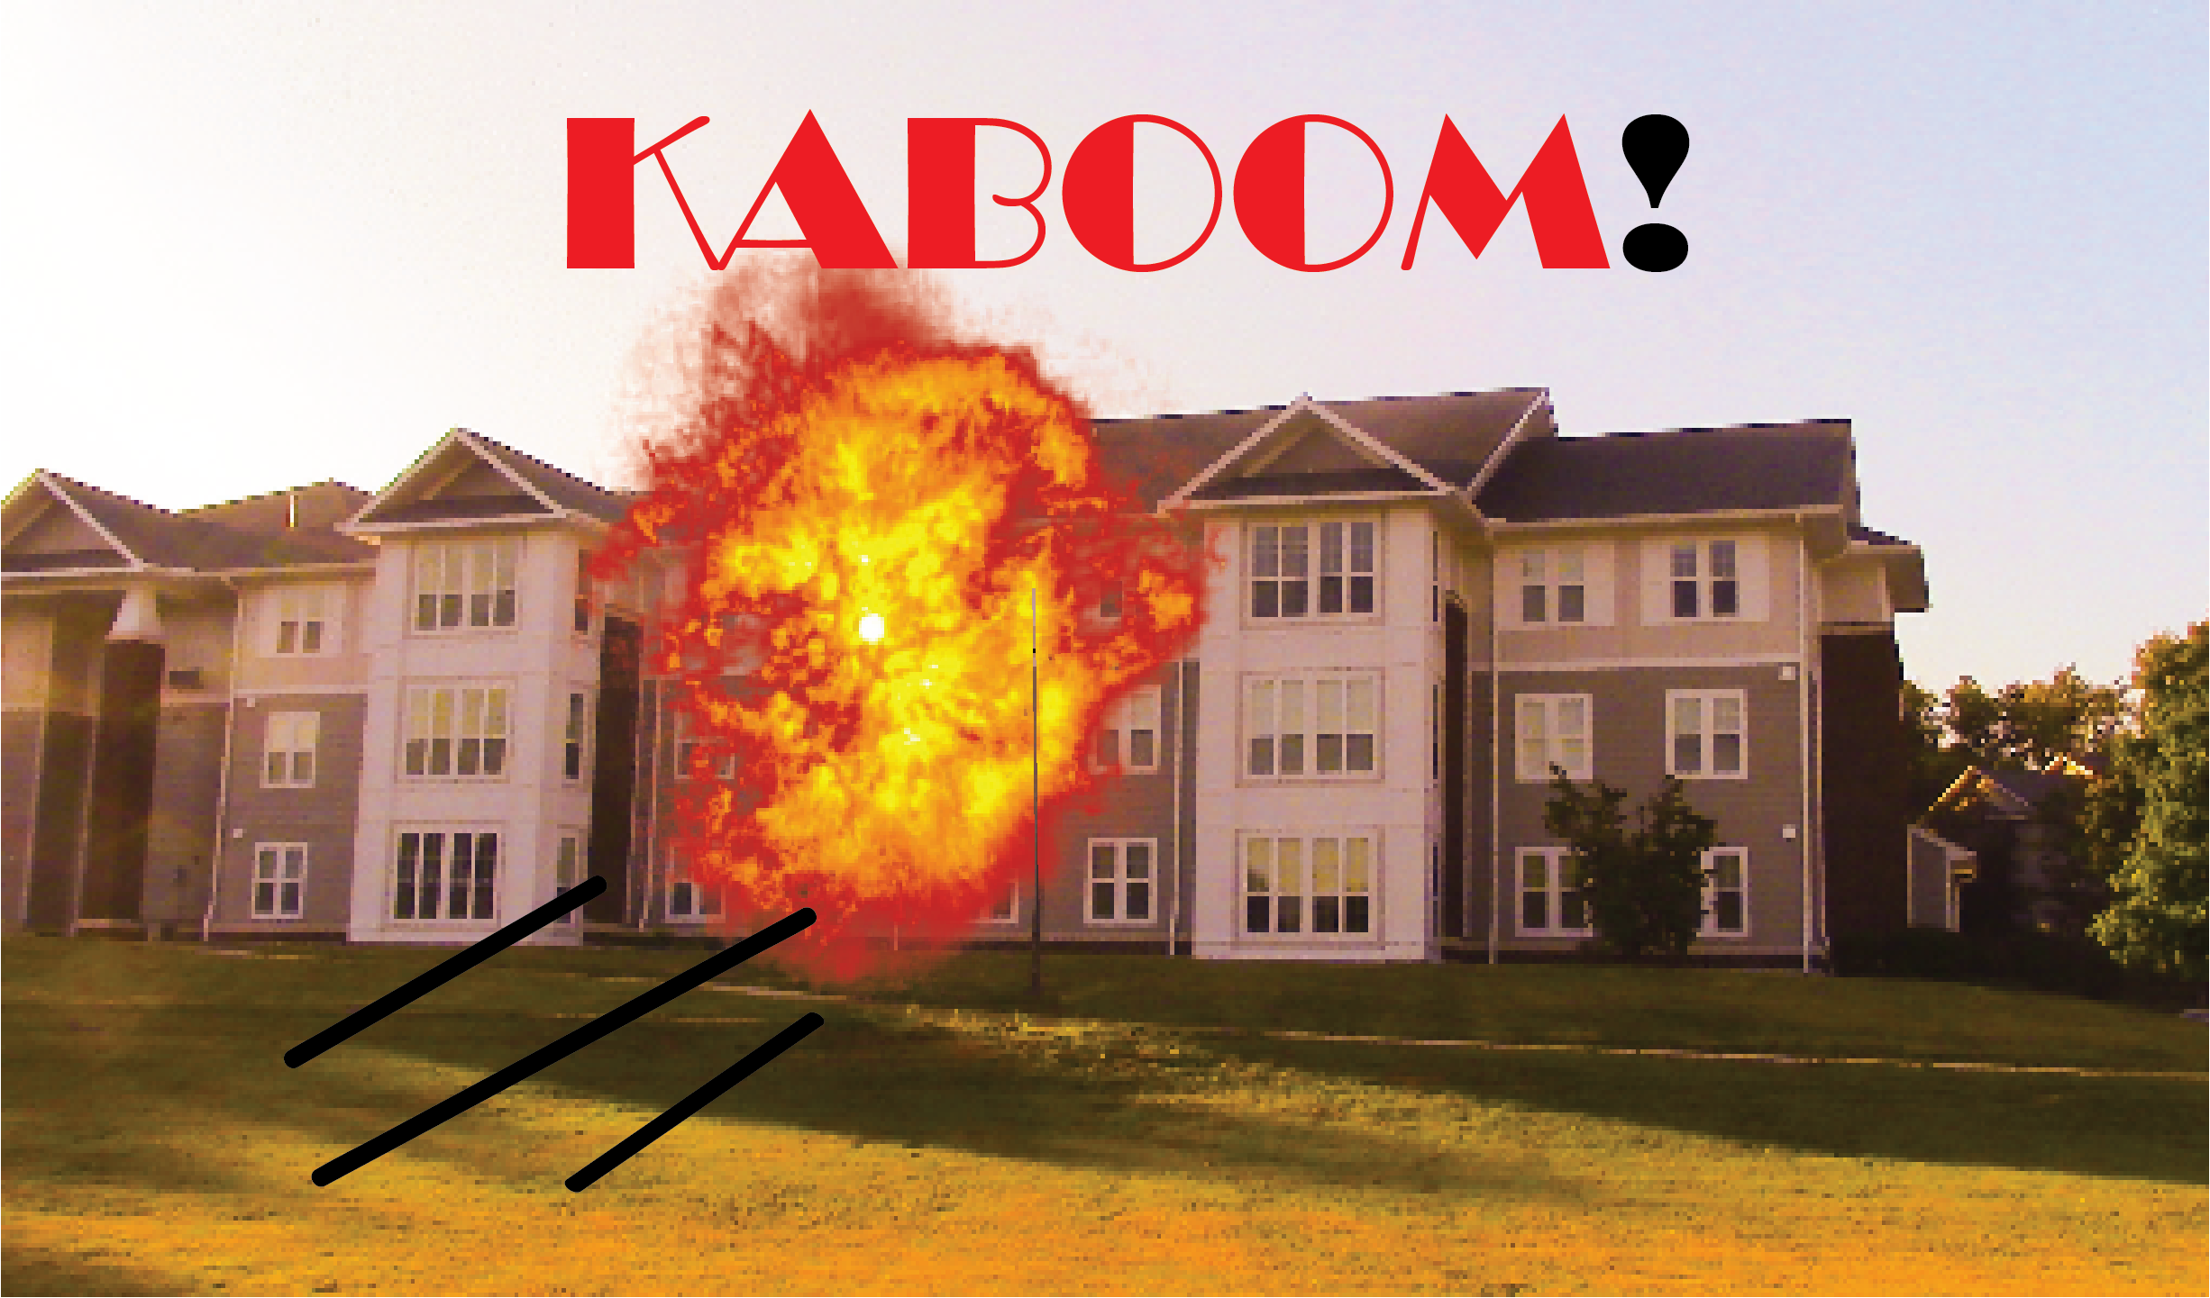

Slide 10
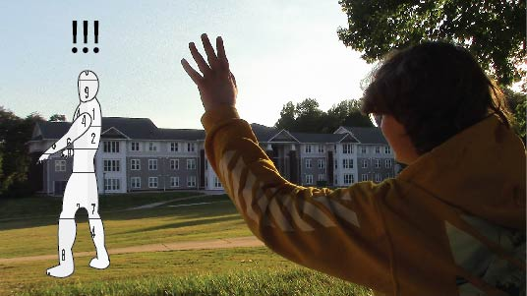

Slide 12
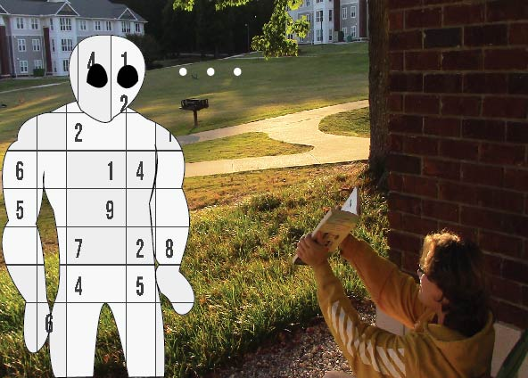
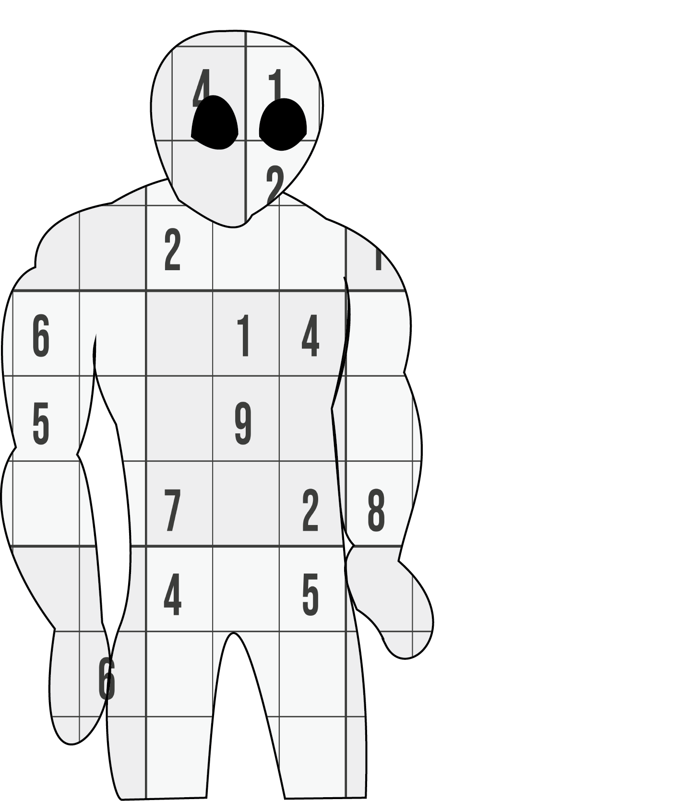

Slide 13
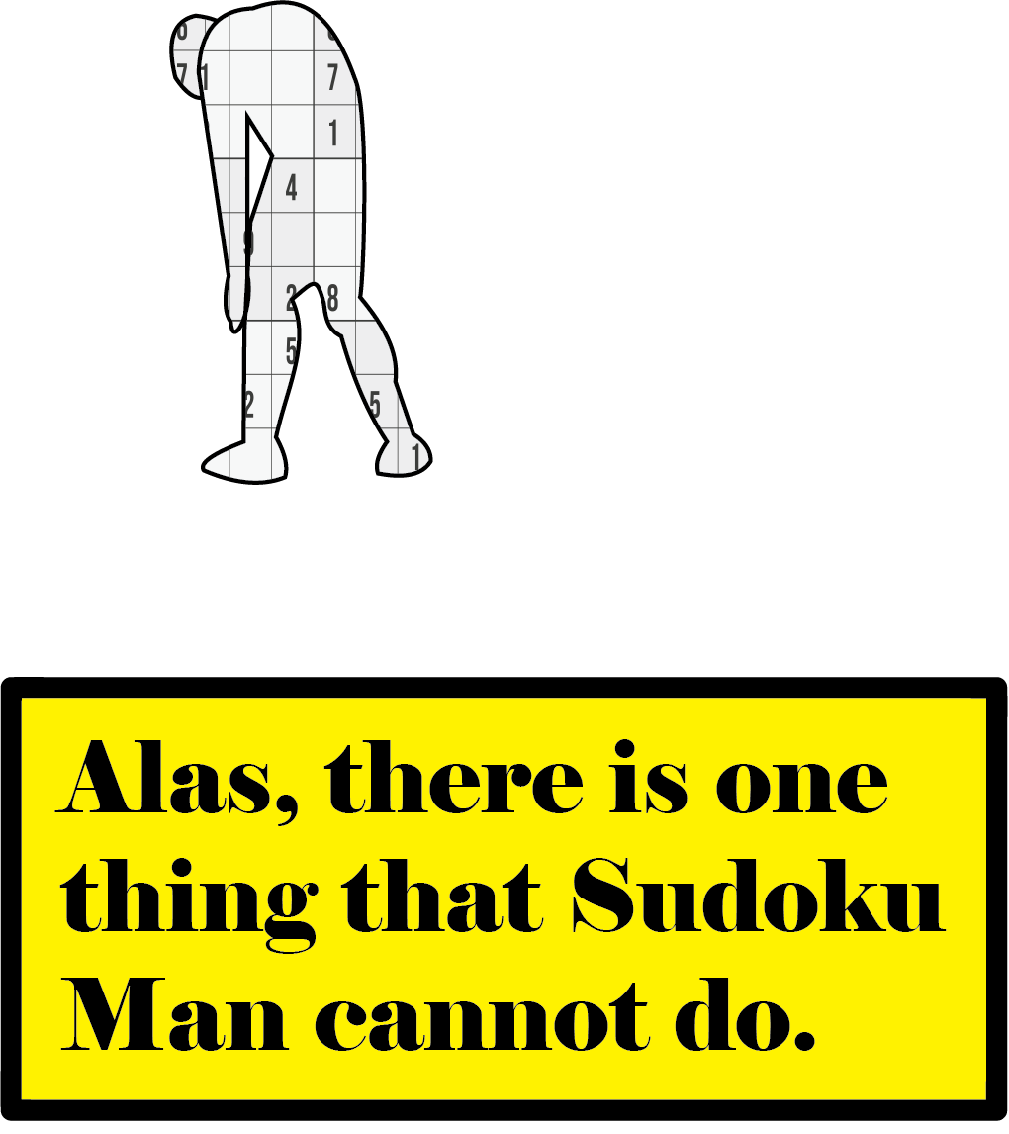

Slide 14
Acknowledgements
Dog Owner – Mary Gaine
Sudoku Lady – Catherine Sikes
Sammy Suckerpunch - Himself
Assistance with Camera – Ryan Johnson
Special Thanks to Matt Torres

Slide 15
Works Cited
Freeiconspng.com. (2014). High quality explosion PNG images - explosion free download - 500X456,287.87 KB. https://www.freeiconspng.com/downloadimg/45944
Madan. (2017). Sudoku easy puzzles, sudoku, sudoku hard, sudoku easy png and vector with transparent background for free download. Pngtree. https://pngtree.com/freepng/sudoku-easy-puzzles_8856278.html

